Slide 1
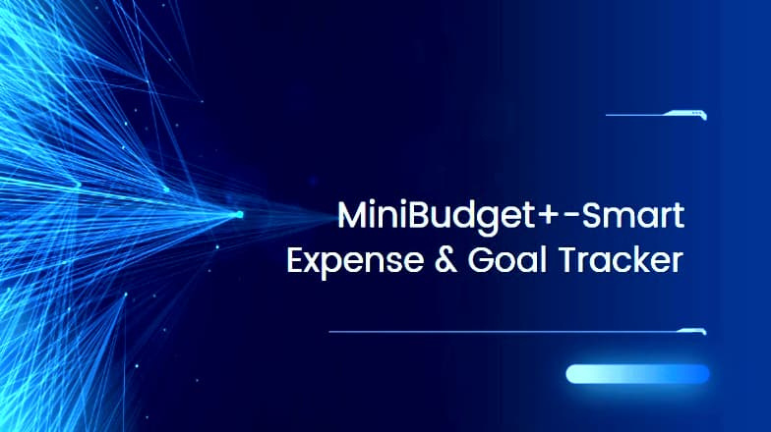
MiniBudget+-Smart
~
Expense &. Goal Tracker

Slide 2
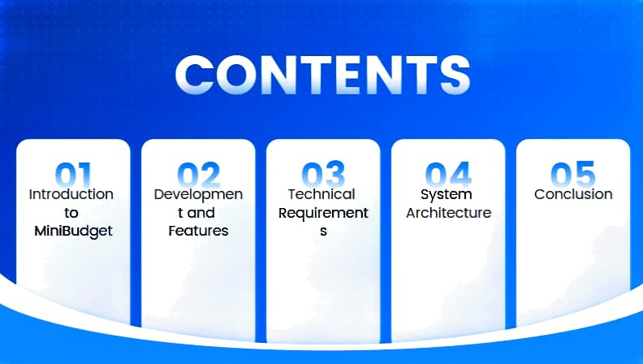
CONTENTS
na:.
ni
t)~
OA
Introduction to
oevelopmen
Technical
system
conclusion
tand
Requirement
s
Architecture
MiniBudget
Features

Slide 3
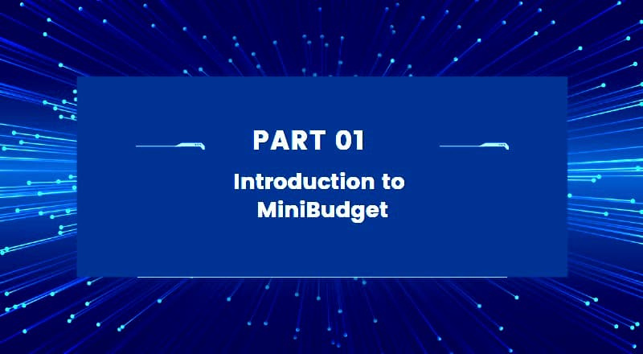
•
•
•
•
•
'
•
•
•
•
•
•
•
•
•
•
•
•
..__
._•,
•
•
•
•
•
•
•
•
•
•
•
. .---
•
•
-~-
.-
~
PART
01
-•
Introduction to
.
•
~
MiniBudget
~
~
.
,,,.
----
,,,-·
•
•.
..
•
•
•
•
•
'
•
•
-~',
•
/
•
•
•
•
•
•
•
•
•

Slide 4
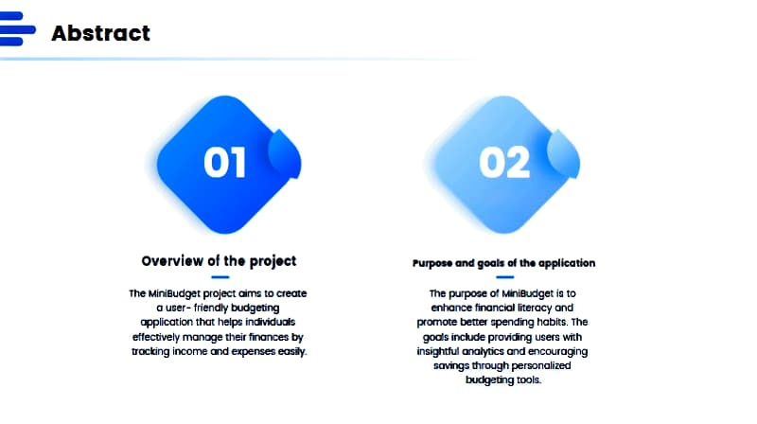
:--Abstract
overview
of
the project
of !he
Clfltlllcarion
l'llrpoN
mMI
goals
purpose
or
MinllkJdget
The MlriBudgel project
aimo
10
aeate
The
Is 10
budgeting
e,
,aoce
financial
literacy and
a ucer-friendly
~
oppli<xltlon IIKII
help$ -
thei,
prcrn<>le -
cpending habits. The
prc,,,kling
effectively manage
fhmc:es
by
goals incule
us.,. wilh
1rocting income and
e,penses
e<lllir(.
insightful analytics and encouro!jng
somgs through persanolired
budgemglOOls.

Slide 5
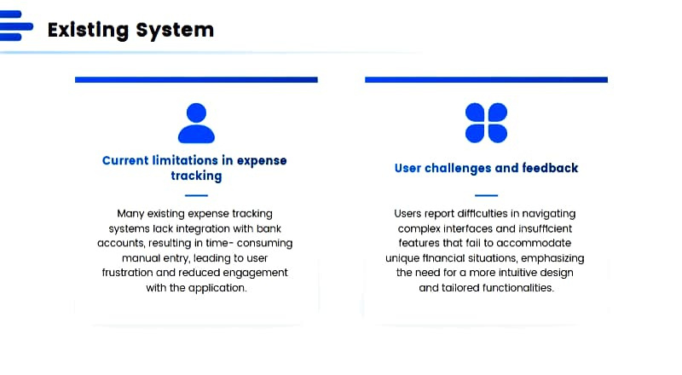
---
Existing system
-•
•
•••
current limitations in expense
User challenges and feedback
tracking
Many existing expense tracking systems lock Integration with bonk accounts, resulting In time-consuming
manual entry, leading to user
frustration and reduced engagement
with the application.
Users report diff1culties in novigoting complex lnterroces and 1nsutt1c1ent features lhot foll to accommodate
unique ttnanclol situations, emphasizing
the need for a more Intuitive design
and tailored functionalities.

Slide 6
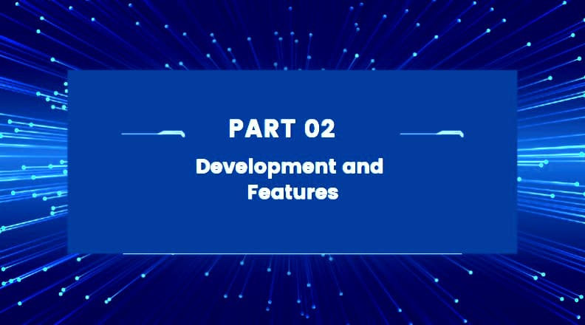
•
•
•
•
•
•
•
•
,
•
•
•
•
•
•
•
•
•
•
•
•
•
•
•
•
......
•
•
•
•
•
•
•
•
__..
...•,
•
•
.
,•
~
PART.02
Development and
•
Features
.
-
,•.
..
~
-
•
•
•
•
•
".•
~
•
•
•
/
•
•
•
•
•
•
•
•

Slide 7
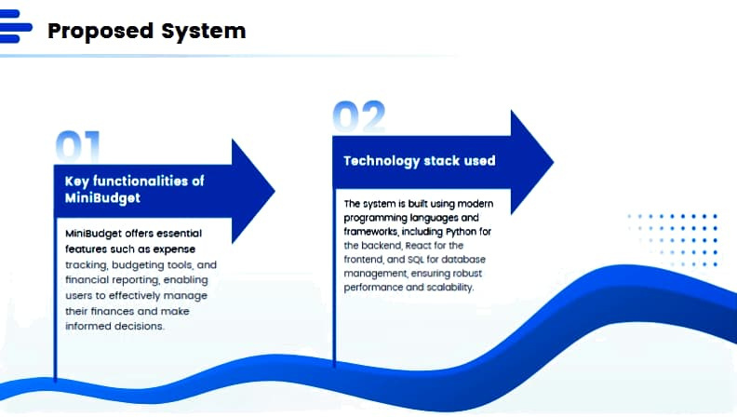
:--Proposed system
l\'TI
Technology
stack used
Key functionalitiea of
MiniBudget
The "f'IOm
l'J
bUlt u<lng
modem
•
prog,onmng
lmguOg••
ond
•
•
•
• • • • • • • • • •
• • • •
indldng
Python for
"4inl8udget olfero 90$91lllal
teawrea such ac expeme
11acking, budgeting 1001,. and
financial reponlng, enabling
users to etfectlvety manage lheir finances and make informed decisions
1rcrnowo1b.
the bockend, Reoa
fo, the
•
• •
•
•
fTontend, and SQl
fo,
clotabo. .
••
manogemem,. emunng robutt
pertamonce
and
GCClat>illty.

Slide 8
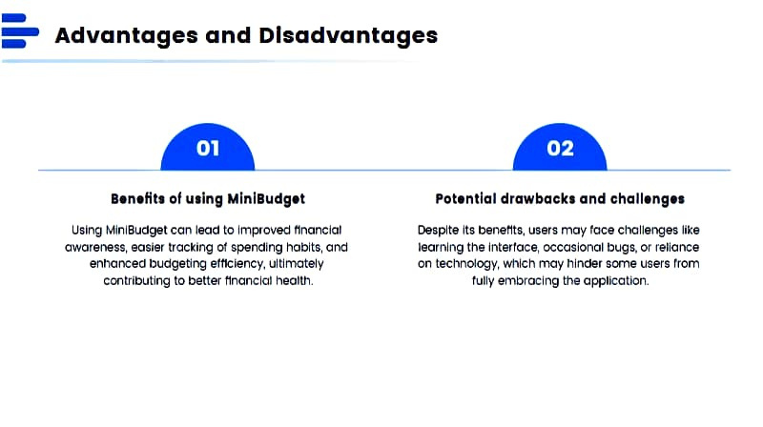
---
Advantages and Disadvantages
BeneHtt of ualng MlnlBudgtt
Potential drawback, and challtng••
Using MlnlBudget con leod to Improved nnanclol awareness, easier tracking of spending habits, ond en11onced 1,udgetlng etlleiency, ultlmotely
Despite Its beneMts, users may toce Cl'IOllenges like reornlng the Interface, occoslonal bugs, or reliance on tec1>no1ogy, wr11ch moy hinder some users rrom
contributing to better Mnonclol health.
tully embracing the oppllcotion.

Slide 9
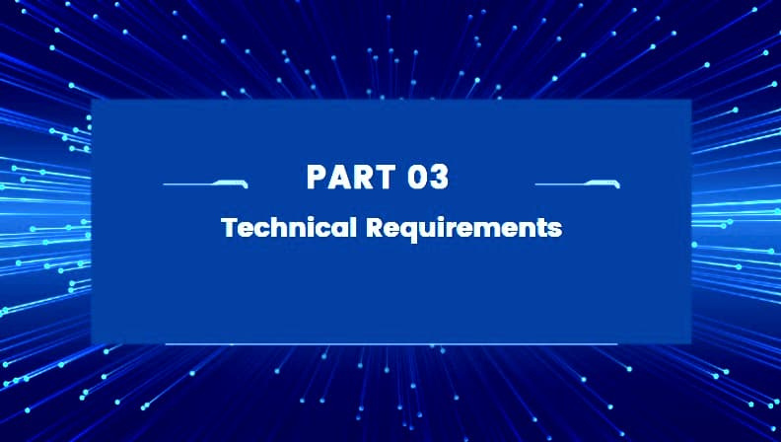
PART03
Technical.R equirements
.,-,
.,,
-~--
•
'
•
•
•
•
•
•
•
•
••
•
/
•
•
•
•
•
•
•
•
•

Slide 10
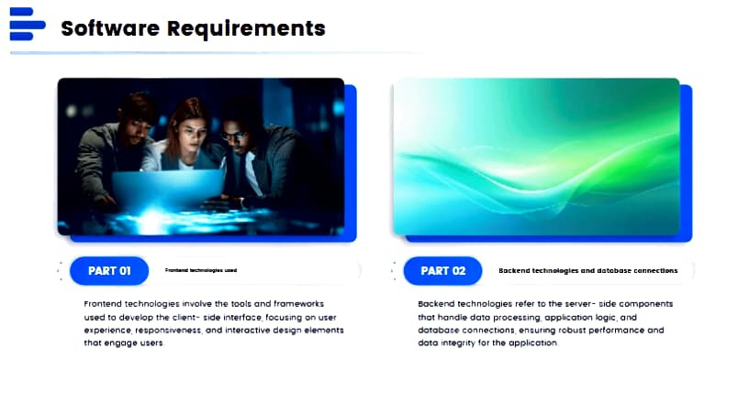
---
Software Requirements
---
PARTOl
P'ro11tend technologies; invotwo the tool, and fromeworb
5ockend technologiei. ,-.:er
to
the s.e,n,er· tide componentl
use-d to d•V•loP
t~
c.ilf'n1-u:I• ,n1t1foce. focus1n'iiil on u1:..­
thot hondl• dolo p1ocHc-1ng oppSt;;otion
'°9ic:.
ond
•1p•rlonc•, r.m:pon~~!"lof-a ond lntqroctlve des:i;:n •'-"'•nu
dotob<IH connactt0n1, •nc1.1ring robust
p,rro,moric:♦
ond
thOt
•ngoge
Utetl
doto if'll9grity !or 1h• oppUeo1,o,n

Slide 11
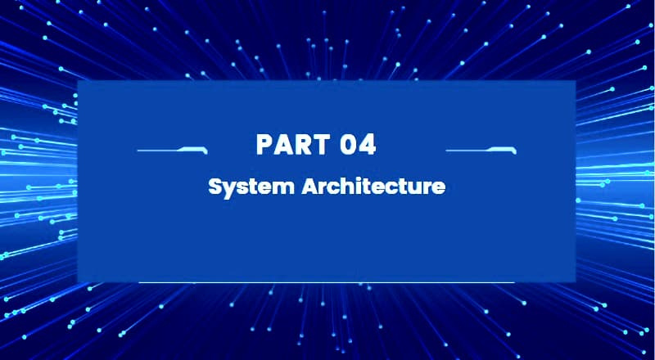
•
•
•
•
•
•
•
•
•
•
•
•
•
•
'
'
•
_...
•
•
•
•
•
•
•
..___
•
•
•
•
•
•
•
•
•
•
••
•
PART 04
,t
.
f}Jil§,
It l
I

Slide 12
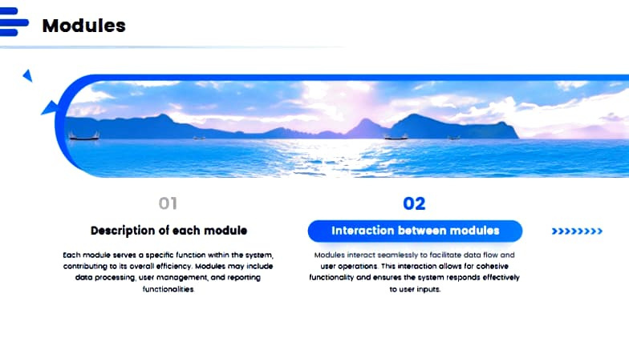
:--Modules
01
02
Dffcrlptlon of each module
Interaction
betwHn
module■
>»»>>>
modut. .....,.,.
nornltutv
Coch
concr1bunnQ
o 1p.crfic tul'\C:hon
wctMn
lt'I• cycr.m,
MOdUIH ri1•t0e1
to locllitot• dotO
tlow
and
In ov..-oll
tttlc!tci~y.
u,., n,onoo,.men,,.
moy ineklde
uatr ope1auon, Thrt .-u•rocdon ollOWI
tcr
eohetlw
to
MOOulN.
d0lo
p,c,«ulng,
ond
r~
tuncoon01tty
and
enWt" me ,y1c•m retpol'dt
oUtct~
functlono!lr.let
10Ut.tf
~ti.

Slide 13
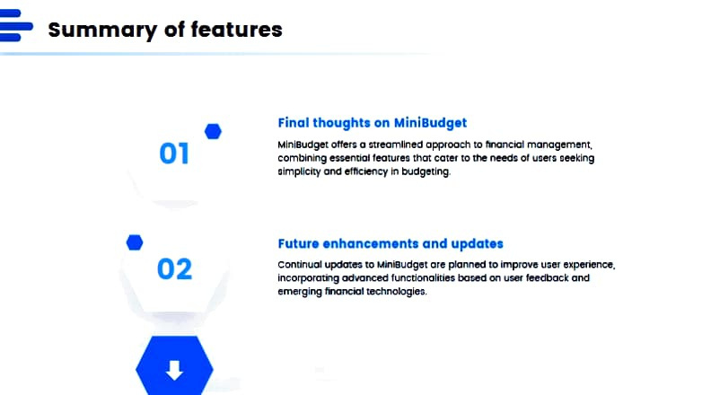
- -
Summary of features
•
Final
thoughts on MiniBudget
01
MlnlBudget offer> a •treomllned opp,ooch
to
flnoncc,I
management,
combining .....,ntiol leotureo that cater to
olmptlclty and efllciency In budgeting.
tl>e
need•
al u•OI• oeeklng
•
Future enhancements and updates
condnuol upclmn to MlniBudget ore plamed to Improve u•er experience, lncorporamg adt,anced luncdonalldes bar.eel on US8f leedbock and emerging fincmclal U!Chnologles.
02
a

Slide 14
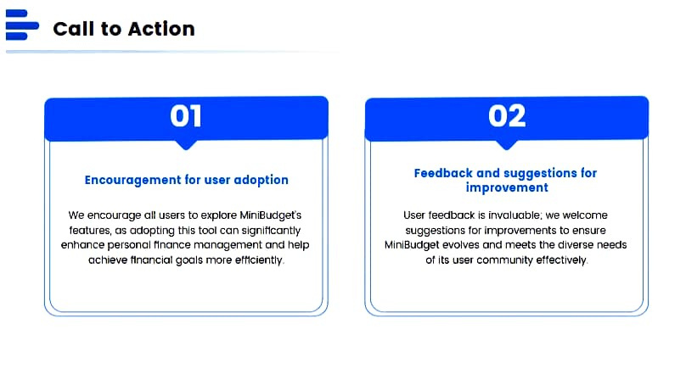
:--Call to Action
Encouragement for user adoption
Feedback and suggestions for
improvement
We encourage all users to explore MiniBudget's features, as adopting this tool con slgnlMcontly
enhance personal Mnonce management end help
User feedback Is invaluable; we welcome suggestions for improvements to ensure
MlnlBudgel evolves end meets the diverse needs
achieve ffnonciot goals more etttciently.
of its user community effectively.

Slide 15

~\N
'"-l
~.. "
">-,
Edited
by
Deekshana Sri ----
Thanks
.
',;ff
. ?,t

